Slide 1
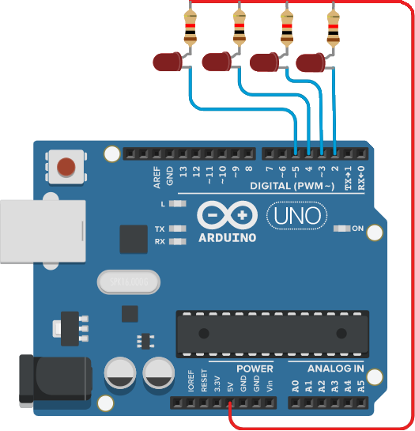
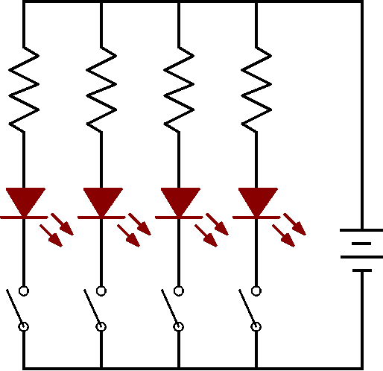
LED 排燈控制
#define N 4
int Led[N]={2,3,4,5};
void setup() {
int i;
for( i=0 ; i<N ; i++){
pinMode(Led[i], OUTPUT);
digitalWrite(Led[i], HIGH);
}
}
void loop() {
int i;
for( i=0 ; i<N ; i++){
digitalWrite(Led[i], LOW);
delay(500);
digitalWrite(Led[i], HIGH);
}
}

Slide 2
LED 排燈控制
#define N 4
int Led[N]={2,3,4,5};
void setup() {
int i;
for( i=0 ; i<N ; i++){
pinMode(Led[i], OUTPUT);
digitalWrite(Led[i], HIGH);
}
}
void loop() {
int i;
for( i=0 ; i<N ; i++){
digitalWrite(Led[i], LOW);
delay(500);
digitalWrite(Led[i], HIGH);
}
}

Slide 3
LED 排燈控制
int Led[4]={2,3,4,5};
void setup() {
int i;
for( i=0 ; i<4 ; i++){
pinMode(Led[i], OUTPUT);
digitalWrite(Led[i], HIGH);
}
}
void loop() {
int i;
for( i=0 ; i<4 ; i++){
digitalWrite(Led[i], LOW);
delay(500);
digitalWrite(Led[i], HIGH);
}
}

Slide 4
LED 排燈控制
int Led[4]={2,3,4,5};
void setup() {
int i;
for( i=0 ; i<4 ; i++){
pinMode(Led[i], OUTPUT);
digitalWrite(Led[i], HIGH);
}
}
void loop() {
int i;
for( i=0 ; i<4 ; i++){
digitalWrite(Led[i], LOW);
delay(500);
digitalWrite(Led[i], HIGH);
}
}
陣列 | 內容
Led[0] | 2
Led[1] | 3
Led[2] | 4
Led[3] | 5

Slide 5
LED 排燈控制
int Led[4]={2,3,4,5};
void setup() {
int i;
for( i=0 ; i<4 ; i++){
pinMode(Led[i], OUTPUT);
digitalWrite(Led[i], HIGH);
}
}
void loop() {
int i;
for( i=0 ; i<4 ; i++){
digitalWrite(Led[i], LOW);
delay(500);
digitalWrite(Led[i], HIGH);
}
}
陣列 | 內容
Led[0] | 2
Led[1] | 3
Led[2] | 4
Led[3] | 5
i

Slide 6
LED 排燈控制
int Led[4]={2,3,4,5};
void setup() {
int i;
for( i=0 ; i<4 ; i++){
pinMode(Led[i], OUTPUT);
digitalWrite(Led[i], HIGH);
}
}
void loop() {
int i;
for( i=0 ; i<4 ; i++){
digitalWrite(Led[i], LOW);
delay(500);
digitalWrite(Led[i], HIGH);
}
}
陣列 | 內容
Led[0] | 2
Led[1] | 3
Led[2] | 4
Led[3] | 5
i=0

Slide 7
LED 排燈控制
int Led[4]={2,3,4,5};
void setup() {
int i;
for( i=0 ; i<4 ; i++){
pinMode(Led[i], OUTPUT);
digitalWrite(Led[i], HIGH);
}
}
void loop() {
int i;
for( i=0 ; i<4 ; i++){
digitalWrite(Led[i], LOW);
delay(500);
digitalWrite(Led[i], HIGH);
}
}
陣列 | 內容
Led[0] | 2
Led[1] | 3
Led[2] | 4
Led[3] | 5
i=0

Slide 8
LED 排燈控制
int Led[4]={2,3,4,5};
void setup() {
int i;
for( i=0 ; i<4 ; i++){
pinMode(Led[i], OUTPUT);
digitalWrite(Led[i], HIGH);
}
}
void loop() {
int i;
for( i=0 ; i<4 ; i++){
digitalWrite(Led[i], LOW);
delay(500);
digitalWrite(Led[i], HIGH);
}
}
陣列 | 內容
Led[0] | 2
Led[1] | 3
Led[2] | 4
Led[3] | 5
i=0
2
2

Slide 9
LED 排燈控制
int Led[4]={2,3,4,5};
void setup() {
int i;
for( i=0 ; i<4 ; i++){
pinMode(Led[i], OUTPUT);
digitalWrite(Led[i], HIGH);
}
}
void loop() {
int i;
for( i=0 ; i<4 ; i++){
digitalWrite(Led[i], LOW);
delay(500);
digitalWrite(Led[i], HIGH);
}
}
陣列 | 內容
Led[0] | 2
Led[1] | 3
Led[2] | 4
Led[3] | 5
i=0
2
2

Slide 10
LED 排燈控制
int Led[4]={2,3,4,5};
void setup() {
int i;
for( i=0 ; i<4 ; i++){
pinMode(Led[i], OUTPUT);
digitalWrite(Led[i], HIGH);
}
}
void loop() {
int i;
for( i=0 ; i<4 ; i++){
digitalWrite(Led[i], LOW);
delay(500);
digitalWrite(Led[i], HIGH);
}
}
陣列 | 內容
Led[0] | 2
Led[1] | 3
Led[2] | 4
Led[3] | 5
i=1
2

Slide 11
LED 排燈控制
int Led[4]={2,3,4,5};
void setup() {
int i;
for( i=0 ; i<4 ; i++){
pinMode(Led[i], OUTPUT);
digitalWrite(Led[i], HIGH);
}
}
void loop() {
int i;
for( i=0 ; i<4 ; i++){
digitalWrite(Led[i], LOW);
delay(500);
digitalWrite(Led[i], HIGH);
}
}
陣列 | 內容
Led[0] | 2
Led[1] | 3
Led[2] | 4
Led[3] | 5
i=1
2

Slide 12
LED 排燈控制
int Led[4]={2,3,4,5};
void setup() {
int i;
for( i=0 ; i<4 ; i++){
pinMode(Led[i], OUTPUT);
digitalWrite(Led[i], HIGH);
}
}
void loop() {
int i;
for( i=0 ; i<4 ; i++){
digitalWrite(Led[i], LOW);
delay(500);
digitalWrite(Led[i], HIGH);
}
}
陣列 | 內容
Led[0] | 2
Led[1] | 3
Led[2] | 4
Led[3] | 5
i=1
3
3
2

Slide 13
LED 排燈控制
int Led[4]={2,3,4,5};
void setup() {
int i;
for( i=0 ; i<4 ; i++){
pinMode(Led[i], OUTPUT);
digitalWrite(Led[i], HIGH);
}
}
void loop() {
int i;
for( i=0 ; i<4 ; i++){
digitalWrite(Led[i], LOW);
delay(500);
digitalWrite(Led[i], HIGH);
}
}
陣列 | 內容
Led[0] | 2
Led[1] | 3
Led[2] | 4
Led[3] | 5
i=1
3
3
2

Slide 14
LED 排燈控制
int Led[4]={2,3,4,5};
void setup() {
int i;
for( i=0 ; i<4 ; i++){
pinMode(Led[i], OUTPUT);
digitalWrite(Led[i], HIGH);
}
}
void loop() {
int i;
for( i=0 ; i<4 ; i++){
digitalWrite(Led[i], LOW);
delay(500);
digitalWrite(Led[i], HIGH);
}
}
陣列 | 內容
Led[0] | 2
Led[1] | 3
Led[2] | 4
Led[3] | 5
i=2
3
2

Slide 15
LED 排燈控制
int Led[4]={2,3,4,5};
void setup() {
int i;
for( i=0 ; i<4 ; i++){
pinMode(Led[i], OUTPUT);
digitalWrite(Led[i], HIGH);
}
}
void loop() {
int i;
for( i=0 ; i<4 ; i++){
digitalWrite(Led[i], LOW);
delay(500);
digitalWrite(Led[i], HIGH);
}
}
陣列 | 內容
Led[0] | 2
Led[1] | 3
Led[2] | 4
Led[3] | 5
i=2
3
2

Slide 16
LED 排燈控制
int Led[4]={2,3,4,5};
void setup() {
int i;
for( i=0 ; i<4 ; i++){
pinMode(Led[i], OUTPUT);
digitalWrite(Led[i], HIGH);
}
}
void loop() {
int i;
for( i=0 ; i<4 ; i++){
digitalWrite(Led[i], LOW);
delay(500);
digitalWrite(Led[i], HIGH);
}
}
陣列 | 內容
Led[0] | 2
Led[1] | 3
Led[2] | 4
Led[3] | 5
i=2
4
4
3
2

Slide 17
LED 排燈控制
int Led[4]={2,3,4,5};
void setup() {
int i;
for( i=0 ; i<4 ; i++){
pinMode(Led[i], OUTPUT);
digitalWrite(Led[i], HIGH);
}
}
void loop() {
int i;
for( i=0 ; i<4 ; i++){
digitalWrite(Led[i], LOW);
delay(500);
digitalWrite(Led[i], HIGH);
}
}
陣列 | 內容
Led[0] | 2
Led[1] | 3
Led[2] | 4
Led[3] | 5
i=2
4
4
3
2

Slide 18
LED 排燈控制
int Led[4]={2,3,4,5};
void setup() {
int i;
for( i=0 ; i<4 ; i++){
pinMode(Led[i], OUTPUT);
digitalWrite(Led[i], HIGH);
}
}
void loop() {
int i;
for( i=0 ; i<4 ; i++){
digitalWrite(Led[i], LOW);
delay(500);
digitalWrite(Led[i], HIGH);
}
}
陣列 | 內容
Led[0] | 2
Led[1] | 3
Led[2] | 4
Led[3] | 5
i=3
4
3
2

Slide 19
LED 排燈控制
int Led[4]={2,3,4,5};
void setup() {
int i;
for( i=0 ; i<4 ; i++){
pinMode(Led[i], OUTPUT);
digitalWrite(Led[i], HIGH);
}
}
void loop() {
int i;
for( i=0 ; i<4 ; i++){
digitalWrite(Led[i], LOW);
delay(500);
digitalWrite(Led[i], HIGH);
}
}
陣列 | 內容
Led[0] | 2
Led[1] | 3
Led[2] | 4
Led[3] | 5
i=3
4
3
2

Slide 20
LED 排燈控制
int Led[4]={2,3,4,5};
void setup() {
int i;
for( i=0 ; i<4 ; i++){
pinMode(Led[i], OUTPUT);
digitalWrite(Led[i], HIGH);
}
}
void loop() {
int i;
for( i=0 ; i<4 ; i++){
digitalWrite(Led[i], LOW);
delay(500);
digitalWrite(Led[i], HIGH);
}
}
陣列 | 內容
Led[0] | 2
Led[1] | 3
Led[2] | 4
Led[3] | 5
i=3
5
5
4
3
2

Slide 21
LED 排燈控制
int Led[4]={2,3,4,5};
void setup() {
int i;
for( i=0 ; i<4 ; i++){
pinMode(Led[i], OUTPUT);
digitalWrite(Led[i], HIGH);
}
}
void loop() {
int i;
for( i=0 ; i<4 ; i++){
digitalWrite(Led[i], LOW);
delay(500);
digitalWrite(Led[i], HIGH);
}
}
陣列 | 內容
Led[0] | 2
Led[1] | 3
Led[2] | 4
Led[3] | 5
i=3
5
5
4
3
2

Slide 22
LED 排燈控制
int Led[4]={2,3,4,5};
void setup() {
int i;
for( i=0 ; i<4 ; i++){
pinMode(Led[i], OUTPUT);
digitalWrite(Led[i], HIGH);
}
}
void loop() {
int i;
for( i=0 ; i<4 ; i++){
digitalWrite(Led[i], LOW);
delay(500);
digitalWrite(Led[i], HIGH);
}
}
陣列 | 內容
Led[0] | 2
Led[1] | 3
Led[2] | 4
Led[3] | 5
i=4
5
4
3
2

Slide 23
LED 排燈控制
int Led[4]={2,3,4,5};
void setup() {
int i;
for( i=0 ; i<4 ; i++){
pinMode(Led[i], OUTPUT);
digitalWrite(Led[i], HIGH);
}
}
void loop() {
int i;
for( i=0 ; i<4 ; i++){
digitalWrite(Led[i], LOW);
delay(500);
digitalWrite(Led[i], HIGH);
}
}
陣列 | 內容
Led[0] | 2
Led[1] | 3
Led[2] | 4
Led[3] | 5
i=4
5
4
3
2

Slide 24
LED 排燈控制
int Led[4]={2,3,4,5};
void setup() {
int i;
for( i=0 ; i<4 ; i++){
pinMode(Led[i], OUTPUT);
digitalWrite(Led[i], HIGH);
}
}
void loop() {
int i;
for( i=0 ; i<4 ; i++){
digitalWrite(Led[i], LOW);
delay(500);
digitalWrite(Led[i], HIGH);
}
}
陣列 | 內容
Led[0] | 2
Led[1] | 3
Led[2] | 4
Led[3] | 5
i=4
5
4
3
2

Slide 25
LED 排燈控制
int Led[4]={2,3,4,5};
void setup() {
int i;
for( i=0 ; i<4 ; i++){
pinMode(Led[i], OUTPUT);
digitalWrite(Led[i], HIGH);
}
}
void loop() {
int i;
for( i=0 ; i<4 ; i++){
digitalWrite(Led[i], LOW);
delay(500);
digitalWrite(Led[i], HIGH);
}
}
陣列 | 內容
Led[0] | 2
Led[1] | 3
Led[2] | 4
Led[3] | 5
i
5
4
3
2

Slide 26
LED 排燈控制
int Led[4]={2,3,4,5};
void setup() {
int i;
for( i=0 ; i<4 ; i++){
pinMode(Led[i], OUTPUT);
digitalWrite(Led[i], HIGH);
}
}
void loop() {
int i;
for( i=0 ; i<4 ; i++){
digitalWrite(Led[i], LOW);
delay(500);
digitalWrite(Led[i], HIGH);
}
}
陣列 | 內容
Led[0] | 2
Led[1] | 3
Led[2] | 4
Led[3] | 5
i=0
5
4
3
2

Slide 27
LED 排燈控制
int Led[4]={2,3,4,5};
void setup() {
int i;
for( i=0 ; i<4 ; i++){
pinMode(Led[i], OUTPUT);
digitalWrite(Led[i], HIGH);
}
}
void loop() {
int i;
for( i=0 ; i<4 ; i++){
digitalWrite(Led[i], LOW);
delay(500);
digitalWrite(Led[i], HIGH);
}
}
陣列 | 內容
Led[0] | 2
Led[1] | 3
Led[2] | 4
Led[3] | 5
i=0
5
4
3
2

Slide 28
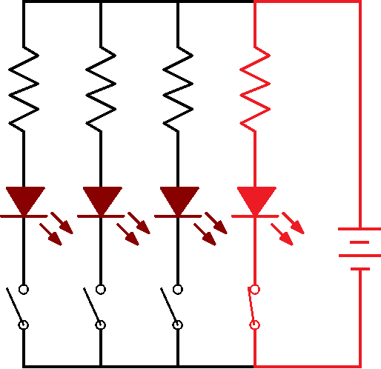
LED 排燈控制
int Led[4]={2,3,4,5};
void setup() {
int i;
for( i=0 ; i<4 ; i++){
pinMode(Led[i], OUTPUT);
digitalWrite(Led[i], HIGH);
}
}
void loop() {
int i;
for( i=0 ; i<4 ; i++){
digitalWrite(Led[i], LOW);
delay(500);
digitalWrite(Led[i], HIGH);
}
}
陣列 | 內容
Led[0] | 2
Led[1] | 3
Led[2] | 4
Led[3] | 5
i=0
5
4
3
2

Slide 29
LED 排燈控制
int Led[4]={2,3,4,5};
void setup() {
int i;
for( i=0 ; i<4 ; i++){
pinMode(Led[i], OUTPUT);
digitalWrite(Led[i], HIGH);
}
}
void loop() {
int i;
for( i=0 ; i<4 ; i++){
digitalWrite(Led[i], LOW);
delay(500);
digitalWrite(Led[i], HIGH);
}
}
陣列 | 內容
Led[0] | 2
Led[1] | 3
Led[2] | 4
Led[3] | 5
i=0
5
4
3
2

Slide 30
LED 排燈控制
int Led[4]={2,3,4,5};
void setup() {
int i;
for( i=0 ; i<4 ; i++){
pinMode(Led[i], OUTPUT);
digitalWrite(Led[i], HIGH);
}
}
void loop() {
int i;
for( i=0 ; i<4 ; i++){
digitalWrite(Led[i], LOW);
delay(500);
digitalWrite(Led[i], HIGH);
}
}
陣列 | 內容
Led[0] | 2
Led[1] | 3
Led[2] | 4
Led[3] | 5
i=0
5
4
3
2

Slide 31
LED 排燈控制
int Led[4]={2,3,4,5};
void setup() {
int i;
for( i=0 ; i<4 ; i++){
pinMode(Led[i], OUTPUT);
digitalWrite(Led[i], HIGH);
}
}
void loop() {
int i;
for( i=0 ; i<4 ; i++){
digitalWrite(Led[i], LOW);
delay(500);
digitalWrite(Led[i], HIGH);
}
}
陣列 | 內容
Led[0] | 2
Led[1] | 3
Led[2] | 4
Led[3] | 5
i=1
5
4
3
2

Slide 32
LED 排燈控制
int Led[4]={2,3,4,5};
void setup() {
int i;
for( i=0 ; i<4 ; i++){
pinMode(Led[i], OUTPUT);
digitalWrite(Led[i], HIGH);
}
}
void loop() {
int i;
for( i=0 ; i<4 ; i++){
digitalWrite(Led[i], LOW);
delay(500);
digitalWrite(Led[i], HIGH);
}
}
陣列 | 內容
Led[0] | 2
Led[1] | 3
Led[2] | 4
Led[3] | 5
i=1
5
4
3
2

Slide 33
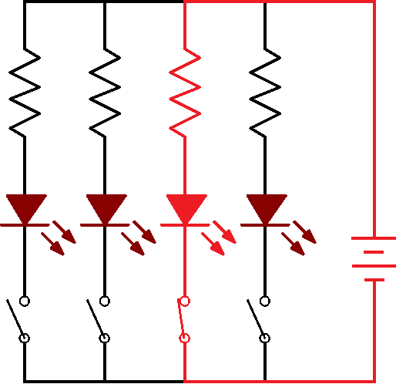
LED 排燈控制
int Led[4]={2,3,4,5};
void setup() {
int i;
for( i=0 ; i<4 ; i++){
pinMode(Led[i], OUTPUT);
digitalWrite(Led[i], HIGH);
}
}
void loop() {
int i;
for( i=0 ; i<4 ; i++){
digitalWrite(Led[i], LOW);
delay(500);
digitalWrite(Led[i], HIGH);
}
}
陣列 | 內容
Led[0] | 2
Led[1] | 3
Led[2] | 4
Led[3] | 5
i=1
5
4
3
2

Slide 34
LED 排燈控制
int Led[4]={2,3,4,5};
void setup() {
int i;
for( i=0 ; i<4 ; i++){
pinMode(Led[i], OUTPUT);
digitalWrite(Led[i], HIGH);
}
}
void loop() {
int i;
for( i=0 ; i<4 ; i++){
digitalWrite(Led[i], LOW);
delay(500);
digitalWrite(Led[i], HIGH);
}
}
陣列 | 內容
Led[0] | 2
Led[1] | 3
Led[2] | 4
Led[3] | 5
i=1
5
4
3
2

Slide 35
LED 排燈控制
int Led[4]={2,3,4,5};
void setup() {
int i;
for( i=0 ; i<4 ; i++){
pinMode(Led[i], OUTPUT);
digitalWrite(Led[i], HIGH);
}
}
void loop() {
int i;
for( i=0 ; i<4 ; i++){
digitalWrite(Led[i], LOW);
delay(500);
digitalWrite(Led[i], HIGH);
}
}
陣列 | 內容
Led[0] | 2
Led[1] | 3
Led[2] | 4
Led[3] | 5
i=1
5
4
3
2

Slide 36
LED 排燈控制
int Led[4]={2,3,4,5};
void setup() {
int i;
for( i=0 ; i<4 ; i++){
pinMode(Led[i], OUTPUT);
digitalWrite(Led[i], HIGH);
}
}
void loop() {
int i;
for( i=0 ; i<4 ; i++){
digitalWrite(Led[i], LOW);
delay(500);
digitalWrite(Led[i], HIGH);
}
}
陣列 | 內容
Led[0] | 2
Led[1] | 3
Led[2] | 4
Led[3] | 5
i=2
5
4
3
2

Slide 37
LED 排燈控制
int Led[4]={2,3,4,5};
void setup() {
int i;
for( i=0 ; i<4 ; i++){
pinMode(Led[i], OUTPUT);
digitalWrite(Led[i], HIGH);
}
}
void loop() {
int i;
for( i=0 ; i<4 ; i++){
digitalWrite(Led[i], LOW);
delay(500);
digitalWrite(Led[i], HIGH);
}
}
陣列 | 內容
Led[0] | 2
Led[1] | 3
Led[2] | 4
Led[3] | 5
i=2
5
4
3
2

Slide 38
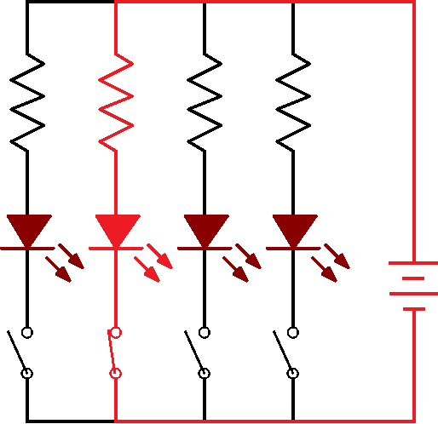
LED 排燈控制
int Led[4]={2,3,4,5};
void setup() {
int i;
for( i=0 ; i<4 ; i++){
pinMode(Led[i], OUTPUT);
digitalWrite(Led[i], HIGH);
}
}
void loop() {
int i;
for( i=0 ; i<4 ; i++){
digitalWrite(Led[i], LOW);
delay(500);
digitalWrite(Led[i], HIGH);
}
}
陣列 | 內容
Led[0] | 2
Led[1] | 3
Led[2] | 4
Led[3] | 5
i=2
5
4
3
2

Slide 39
LED 排燈控制
int Led[4]={2,3,4,5};
void setup() {
int i;
for( i=0 ; i<4 ; i++){
pinMode(Led[i], OUTPUT);
digitalWrite(Led[i], HIGH);
}
}
void loop() {
int i;
for( i=0 ; i<4 ; i++){
digitalWrite(Led[i], LOW);
delay(500);
digitalWrite(Led[i], HIGH);
}
}
陣列 | 內容
Led[0] | 2
Led[1] | 3
Led[2] | 4
Led[3] | 5
i=2
5
4
3
2

Slide 40
LED 排燈控制
int Led[4]={2,3,4,5};
void setup() {
int i;
for( i=0 ; i<4 ; i++){
pinMode(Led[i], OUTPUT);
digitalWrite(Led[i], HIGH);
}
}
void loop() {
int i;
for( i=0 ; i<4 ; i++){
digitalWrite(Led[i], LOW);
delay(500);
digitalWrite(Led[i], HIGH);
}
}
陣列 | 內容
Led[0] | 2
Led[1] | 3
Led[2] | 4
Led[3] | 5
i=2
5
4
3
2

Slide 41
LED 排燈控制
int Led[4]={2,3,4,5};
void setup() {
int i;
for( i=0 ; i<4 ; i++){
pinMode(Led[i], OUTPUT);
digitalWrite(Led[i], HIGH);
}
}
void loop() {
int i;
for( i=0 ; i<4 ; i++){
digitalWrite(Led[i], LOW);
delay(500);
digitalWrite(Led[i], HIGH);
}
}
陣列 | 內容
Led[0] | 2
Led[1] | 3
Led[2] | 4
Led[3] | 5
i=3
5
4
3
2

Slide 42
LED 排燈控制
int Led[4]={2,3,4,5};
void setup() {
int i;
for( i=0 ; i<4 ; i++){
pinMode(Led[i], OUTPUT);
digitalWrite(Led[i], HIGH);
}
}
void loop() {
int i;
for( i=0 ; i<4 ; i++){
digitalWrite(Led[i], LOW);
delay(500);
digitalWrite(Led[i], HIGH);
}
}
陣列 | 內容
Led[0] | 2
Led[1] | 3
Led[2] | 4
Led[3] | 5
i=3
5
4
3
2

Slide 43
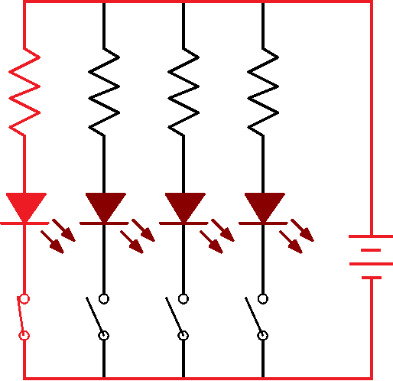
LED 排燈控制
int Led[4]={2,3,4,5};
void setup() {
int i;
for( i=0 ; i<4 ; i++){
pinMode(Led[i], OUTPUT);
digitalWrite(Led[i], HIGH);
}
}
void loop() {
int i;
for( i=0 ; i<4 ; i++){
digitalWrite(Led[i], LOW);
delay(500);
digitalWrite(Led[i], HIGH);
}
}
陣列 | 內容
Led[0] | 2
Led[1] | 3
Led[2] | 4
Led[3] | 5
i=3
5
4
3
2

Slide 44
LED 排燈控制
int Led[4]={2,3,4,5};
void setup() {
int i;
for( i=0 ; i<4 ; i++){
pinMode(Led[i], OUTPUT);
digitalWrite(Led[i], HIGH);
}
}
void loop() {
int i;
for( i=0 ; i<4 ; i++){
digitalWrite(Led[i], LOW);
delay(500);
digitalWrite(Led[i], HIGH);
}
}
陣列 | 內容
Led[0] | 2
Led[1] | 3
Led[2] | 4
Led[3] | 5
i=3
5
4
3
2

Slide 45
LED 排燈控制
int Led[4]={2,3,4,5};
void setup() {
int i;
for( i=0 ; i<4 ; i++){
pinMode(Led[i], OUTPUT);
digitalWrite(Led[i], HIGH);
}
}
void loop() {
int i;
for( i=0 ; i<4 ; i++){
digitalWrite(Led[i], LOW);
delay(500);
digitalWrite(Led[i], HIGH);
}
}
陣列 | 內容
Led[0] | 2
Led[1] | 3
Led[2] | 4
Led[3] | 5
i=3
5
4
3
2

Slide 46
LED 排燈控制
int Led[4]={2,3,4,5};
void setup() {
int i;
for( i=0 ; i<4 ; i++){
pinMode(Led[i], OUTPUT);
digitalWrite(Led[i], HIGH);
}
}
void loop() {
int i;
for( i=0 ; i<4 ; i++){
digitalWrite(Led[i], LOW);
delay(500);
digitalWrite(Led[i], HIGH);
}
}
陣列 | 內容
Led[0] | 2
Led[1] | 3
Led[2] | 4
Led[3] | 5
i=4
5
4
3
2

Slide 47
LED 排燈控制
int Led[4]={2,3,4,5};
void setup() {
int i;
for( i=0 ; i<4 ; i++){
pinMode(Led[i], OUTPUT);
digitalWrite(Led[i], HIGH);
}
}
void loop() {
int i;
for( i=0 ; i<4 ; i++){
digitalWrite(Led[i], LOW);
delay(500);
digitalWrite(Led[i], HIGH);
}
}
陣列 | 內容
Led[0] | 2
Led[1] | 3
Led[2] | 4
Led[3] | 5
i=4
5
4
3
2

Slide 48
LED 排燈控制
int Led[4]={2,3,4,5};
void setup() {
int i;
for( i=0 ; i<4 ; i++){
pinMode(Led[i], OUTPUT);
digitalWrite(Led[i], HIGH);
}
}
void loop() {
int i;
for( i=0 ; i<4 ; i++){
digitalWrite(Led[i], LOW);
delay(500);
digitalWrite(Led[i], HIGH);
}
}
陣列 | 內容
Led[0] | 2
Led[1] | 3
Led[2] | 4
Led[3] | 5
i=4
5
4
3
2

Slide 49
LED 排燈控制
int Led[4]={2,3,4,5};
void setup() {
int i;
for( i=0 ; i<4 ; i++){
pinMode(Led[i], OUTPUT);
digitalWrite(Led[i], HIGH);
}
}
void loop() {
int i;
for( i=0 ; i<4 ; i++){
digitalWrite(Led[i], LOW);
delay(500);
digitalWrite(Led[i], HIGH);
}
}
陣列 | 內容
Led[0] | 2
Led[1] | 3
Led[2] | 4
Led[3] | 5
i
5
4
3
2

